Slide 1

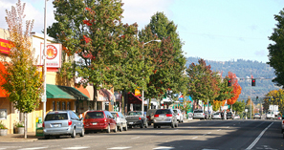
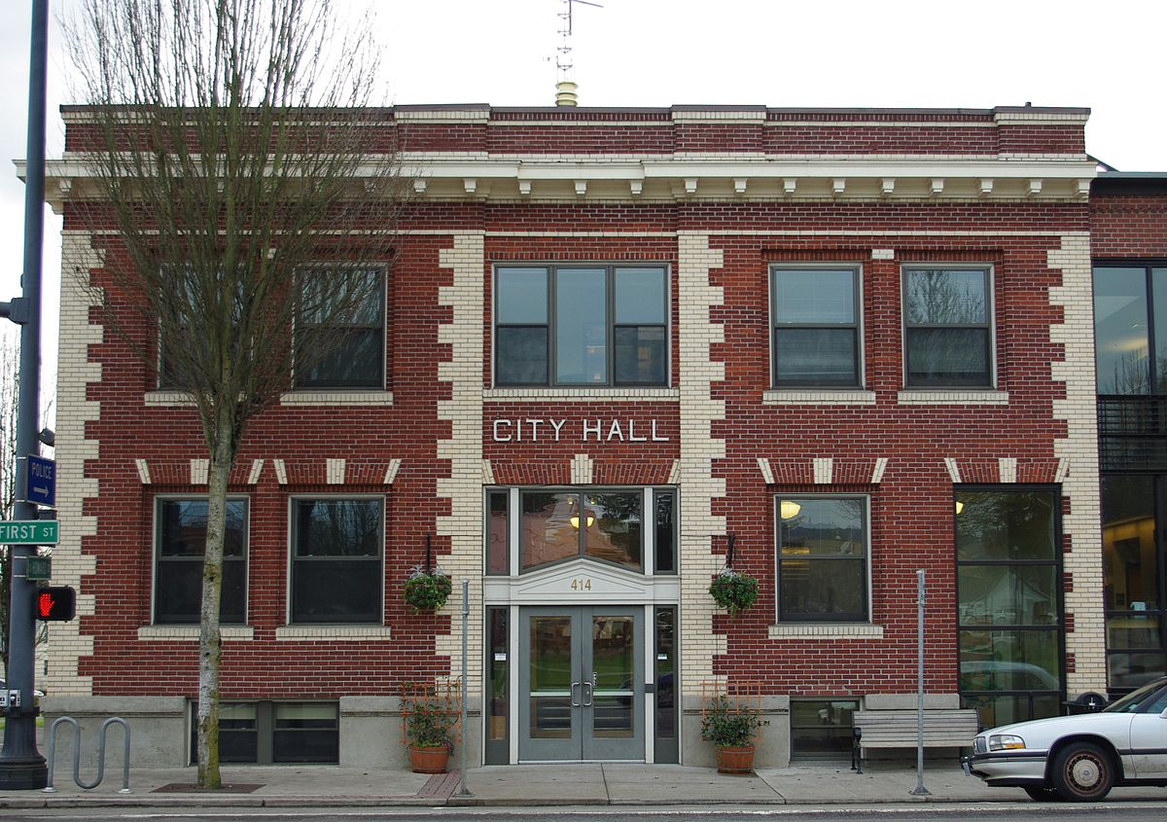
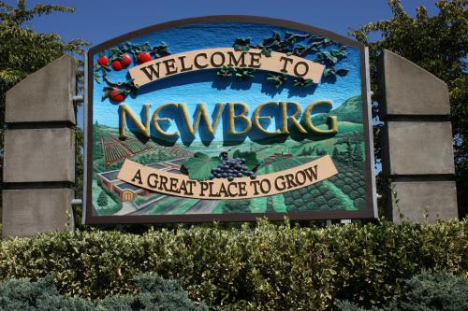
Newberg 2030
Meeting #1

Slide 2
Agenda
I. Introductions (5 minutes)
II. Overview of the Project (10 min)
III. Overview of Division 38 (10 min)
IV. Study Area Determination (20 min)
V. Serviceability Methods (60 min)
VI. Next Steps (10 min)

Slide 3
Overview: How we got here

Slide 4
Context
Background
Unsuccessful multi-year attempt at a UGB expansion for industrial land
The need to accommodate future population and employment growth
OAR 660 Division 38 simplified method
DLCD grant for UGB prep work/BLI
DLCD grant for Division 38 boundary review

Slide 5
Context
Project goal: Conduct UGB review using Division 38 rule
Develop a community vision, goals and policies
Conduct Division 38 Boundary Review
  Determine land needs
  Inventory land (BLI)
  Identify land deficiencies
  Define UGB study area consistent with Division 38 requirements
  Identify proposed expansion areas
  Conduct serviceability analysis
  Prepare findings

Slide 6
Overview of Division 38
Simplified UGB amendment method
  OAR 660-038
  New rule, Newberg will be first to test
Newberg’s 2017 BLI is consistent with the Division 38 guidance
  Identified some issues with the rule in the BLI
  LCDC will address these later this year
  Cannot move forward with parts of the project without the changes
Notes:
[Bob]

Slide 7
The Division 38 Simplified UGB Method

Slide 8
Division 38: Simplified UGB Process Objectives
Become the methods that are used by most cities
Encourage livable communities and “land use efficiency”
Encourage the conservation of farm and forest lands
Encourage cities to increase the development capacity within their UGBs
Encourage provision of an adequate supply of serviceable residential and employment land
Assist residents in understanding the major local government decisions that are likely to determine the form of a city’s growth

Slide 9
Division 38: Major provisions
Builds from PSU population forecast (available July 2017)
Uses a 14-year period
Land can be serviced
Outlines when cities can apply for additional UGB amendments

Slide 10
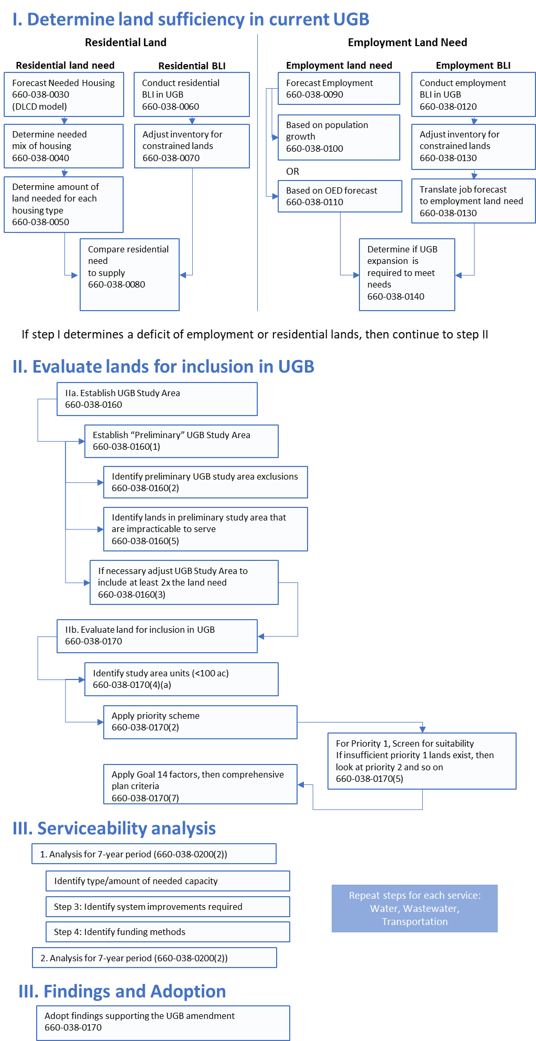
Major Process Steps
Determine land sufficiency within current UGB
  Land Need
  Land supply
  Determine deficiencies
Evaluate lands for inclusion in UGB
  Establish preliminary study area
  Refine study area (final study area)
Serviceability analysis
Findings and adoption

Slide 11
Preliminary Study Area Determination
Notes:
[City staff]

Slide 12
Study Area Determination
OAR 660-038-0160
  Establishment of Study Area to Evaluate Land for Inclusion in the UGB.
  “Cities shall comply with this rule and OAR 660-038-0170 when determining which lands to include within the UGB in response to a deficit of land to meet long-term needs determined under OAR 660-038-0080, 660-038-0150, or both.”
Land within Newberg UGB
Lands outside Newberg UGB, including Urban Reserves
Notes:
[Bob]

Slide 13
Study Area: Steps
OAR 660-038-0160(1) – Preliminary Study Area
  All lands in the city’s acknowledged urban reserve
  All lands within one mile of the UGB
  Exceptions areas within 1.5 miles of the UGB

Slide 15
Study Area: Exclusions
Areas in Marion County - impracticable service (OAR 660-038-0160(7)(b))
Landslide areas – identified in DOGAMI
“SLIDO” 4.3 database (OAR 660-038-0160(2)(b)(A))
Flood areas – areas in FEMA Special Flood Hazard Area (OAR 660-038-0160(2)(b)(B))
Dundee UGB – Shall not include areas within another UGB (660-038-0160(1))

Slide 16
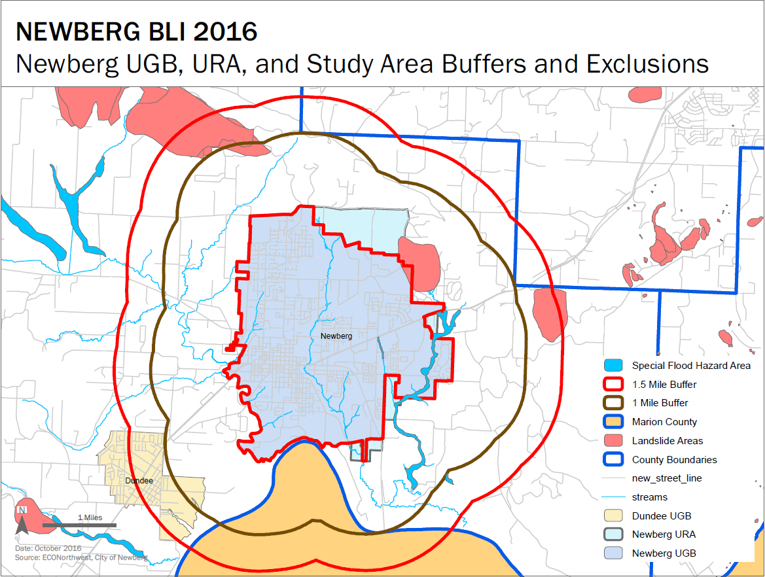

Slide 17
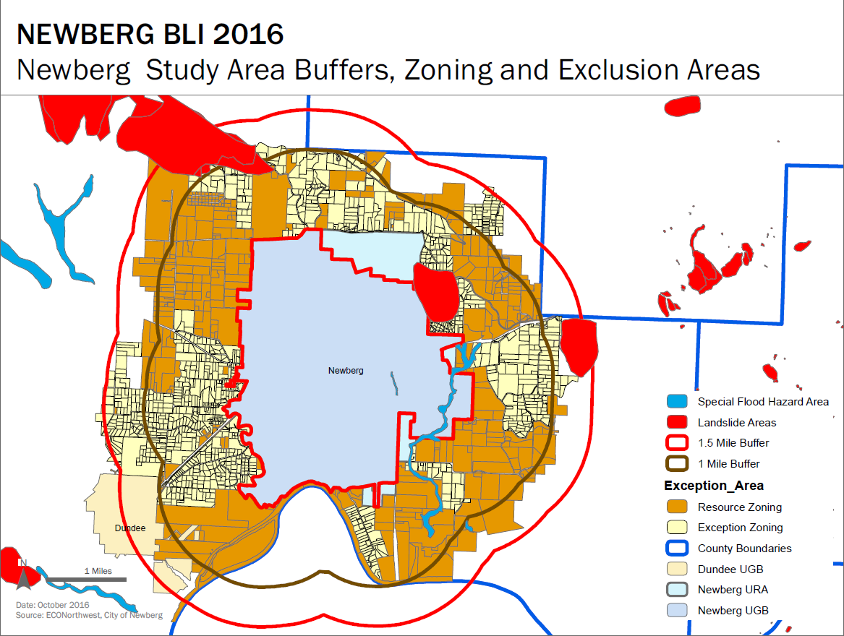

Slide 18
Urban Reserve Land
551 Acres in URAs
527 in TL
75 Dwelling Units
~50% of land in lots over 10 acres

Slide 19
UGB Study Area: Statistics
More than 19,800 acres in 1.5-mile study area (does not include URA)
4,325 acres in exceptions areas
Few lots over 20 acres in exceptions areas

Slide 20
Study Area
Study Area Lots by Zoning and Classification

Slide 21
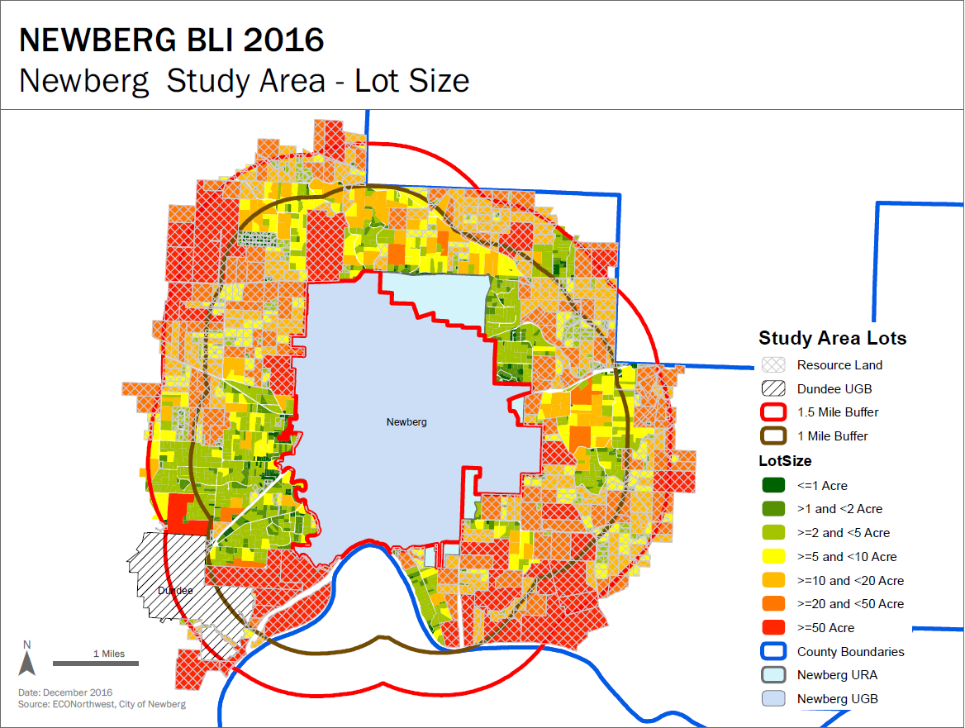

Slide 22
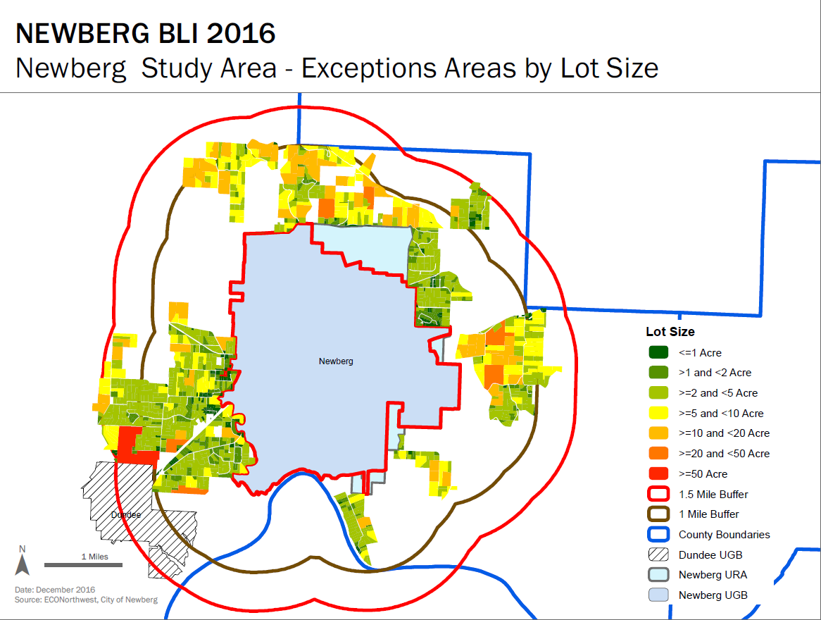

Slide 25
Study Area Determination
Exclusions in preliminary study area
  Areas in Marion Co.
  Landslide areas
  Flood areas
  Dundee UGB
Potential exclusions in final study area
  Additional public service exclusions
  Phase II of Newberg-Dundee Bypass
  Land isolated from existing service networks
    E.g., physical, topographic constraints
Notes:
[Bob]

Slide 26
Serviceability Analysis
Notes:
[Bob]

Slide 27
Serviceability Methods
OAR 660-038-0200
  Serviceability.
  “A city that amends its UGB using this division shall demonstrate that lands included within the UGB: (a) Provide sufficient serviceable land for at least a seven-year period, and (b) Can all be serviceable over a 14-year period.”
(1) Pursuant to ORS 197A.310(3) or 197A.312(3), a city that amends its UGB using this division shall demonstrate that lands included within the UGB:
  (a) Provide sufficient serviceable land for at least a seven-year period, and
  (b) Can all be serviceable over a 14-year period.
Notes:
[Bob/Dave]

Slide 28
Serviceability Methods
Serviceability analysis steps
  Requires determination of amount and location of boundary amendment
Services included:
  Wastewater; water
  Transportation
  Financing
Step 1: Determine growth increments
Step 2: Identify type/amount of needed capacity
Repeat steps 2-4 for each:
Step 3: Identify system improvements required
Wastewater/water
Transportation
Step 4: Identify funding methods
Financing
Notes:
[Bob/Dave]

Slide 29
Seven-Year Period (Subsection 2)
A city shall demonstrate adequate sewer, water and transportation capacity.
  (a) Capacity is available: existing sewer, water and transportation system capacity sufficient to serve some or all of the anticipated seven-year demand is available…and/or
  (b) Capacity can be provided within seven years
    (A) Are fully funded and scheduled for construction
    (B) Can be made subject to committed financing, or
    (C) Can have committed financing in place
Notes:
[Bob/Dave]

Slide 30
14-Year Period (Subsection 3)
Capacity can be in place for that portion of the 14-year period for which capacity has not been demonstrated
  (a) Identify the type and amount of the needed capacity;
  (b) Identify the system improvements required to provide the needed capacity; and,
  (c) Identify the funding method(s)

Slide 31
Discussion
Key issues:
  Agreement with rule interpretation
  What level of detail is required?
  Does the rule require site specific analysis of expansion areas?

Slide 32
Next Steps
Develop preliminary land need estimates (constrained by BLI)
Refine study area
Conduct preliminary serviceability analysis for residential uses in Urban Reserve Areas
Notes:
[Bob]

