Slide 1
Amend the Collina at Springbrook Subdivision Phasing Plan and Springbrook Master Plan Development Standards Matrix
MIMD323-0003/MISC323-0001
Planning Commission Public Hearing April 11, 2024

Slide 2
Background
Applicant: Pahlisch Homes, Inc
Owner: Aspen Way West LLC
Request: Amend the Collina at Springbrook subdivision phasing plan and Amend the Springbrook Master Plan Development Standards Matrix (Previous approval was under Order No. 2023-44 and Ordinance No. 2023-2915)
Location: Subdivision - North of N Mountainview Drive, west of Hess Creek, east of N College Street, and southwest of N Aspen Way - 98.81 acres
Tax Lots: R32 04900, R32 05000, R32 05100, R32 05200, R32 05300, R32 05400, R3208 05500, R3208 05800, R32 06200, R32 06300, R32 06400
Zoning: SD/LDR (Low Density Residential)

Slide 3
Background
Applicable Criteria (Phasing): NMC 15.235 – Land Divisions, 15.326 Springbrook District and Order No. 2023-44
Applicable Criteria (Master Plan Matrix): NMC 15.236 Springbrook District, 15.505 Public Improvement Standards, Newberg Comprehensive Plan, Statewide Planning Goals, Order No. 2023-44 and Ordinance No. 2023-2915

Slide 4
Location Subdivision

Slide 5
Zoning - Subdivision

Slide 6
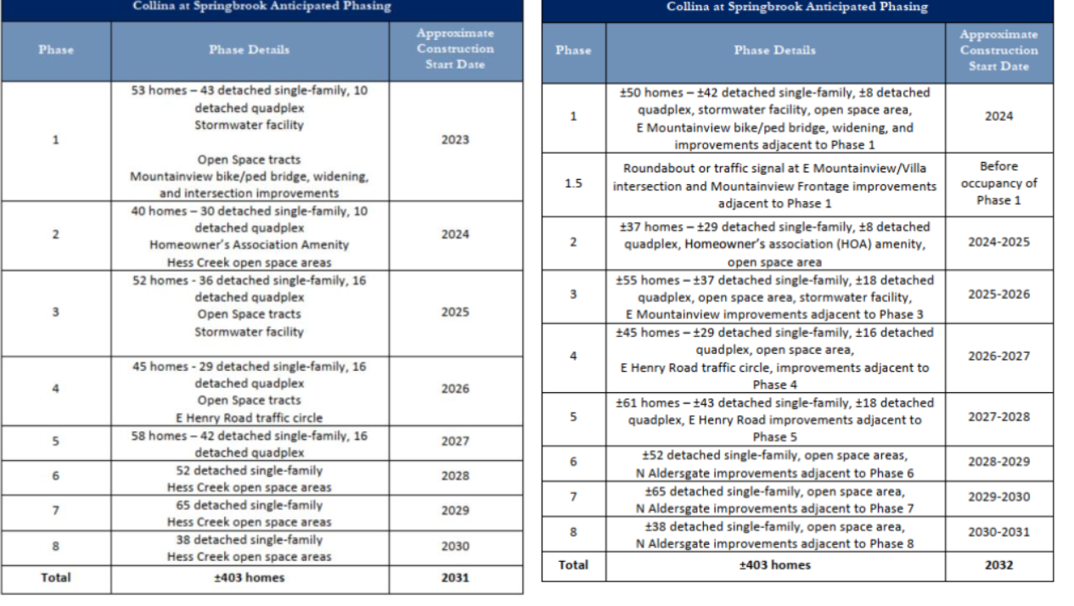
Phasing Plan Comparison
C
U
R
R
E
N
T
L
Y
A
P
P
R
O
V
E
D
P
R
O
P
O
S
E
D

Slide 7
Phasing Plan Changes
Splits 1 open space tract (Tract G) into 2 lots in Phases 1 and 2.
Adds Phase 1.5 for roundabout or traffic signal
Splits E Mountainview Drive improvements between Phase 1 (also 1.5) and 3 for better timing of stormwater facilities
Re-numbers lots
Provides clarification on when adjacent improvements are to occur

Slide 8
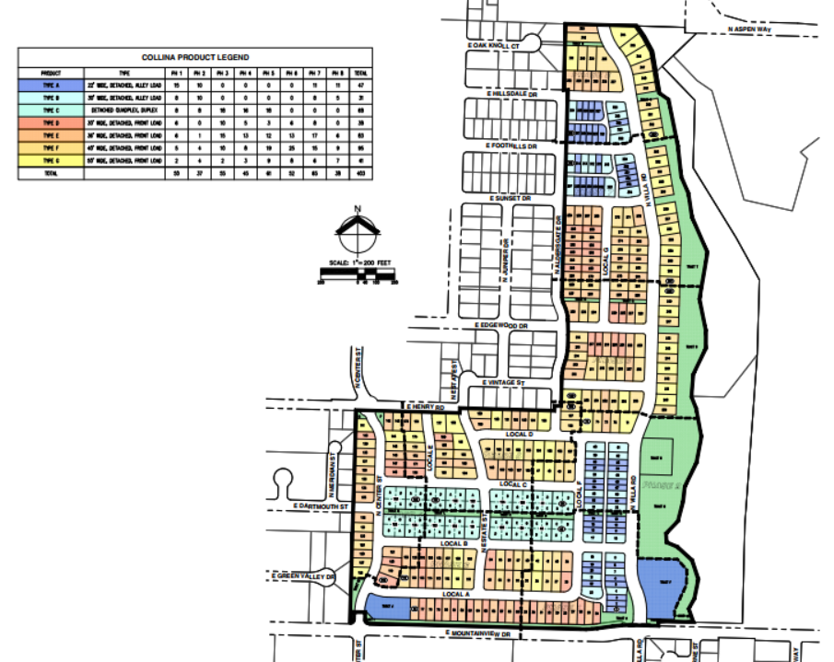
Phasing Plan Comparison
Previously Approved Phasing Map
Tract G

Slide 9
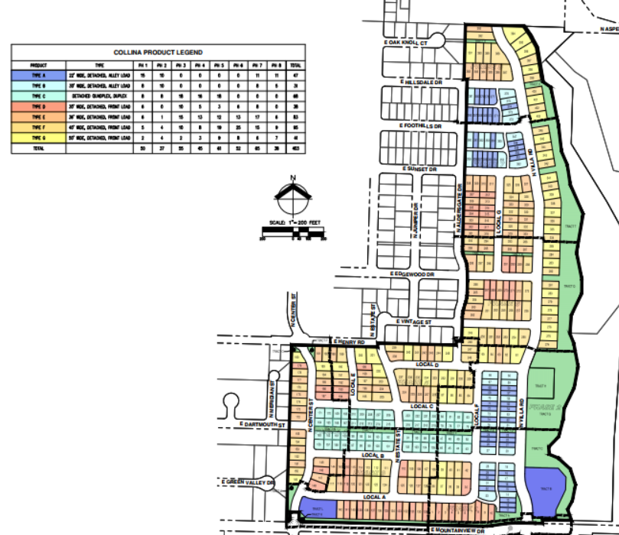
Phasing Plan Comparison
Proposed Phasing Map
Original Tract G split into 2 phases (1 and 2)
Phase 1.5 added for roundabout or traffic signal

Slide 10
Phasing Findings & Conditions
Exhibit “A”: Findings – File MIMD323-0003
Only one lot is changing phases/location in the approximately 420 lots which is well below the 10% requirement
Lot re-numbering was not consistent with original plan and conditions, suggested conditions of approval deal with this including a Type I application to reflect the new lot numbers.
Proposed timing of phases was only pushed back a year from original timing
Five (5) conditions of approval recommended in Exhibit “D”

Slide 11
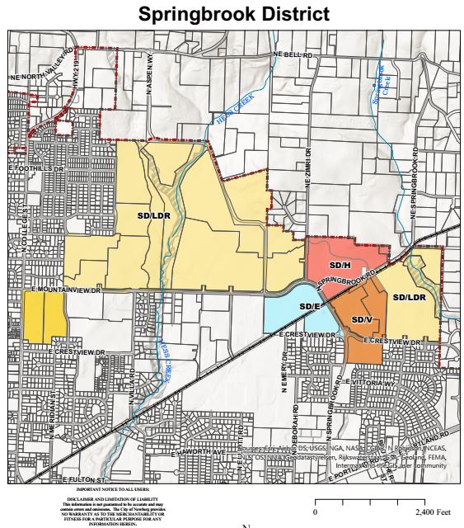
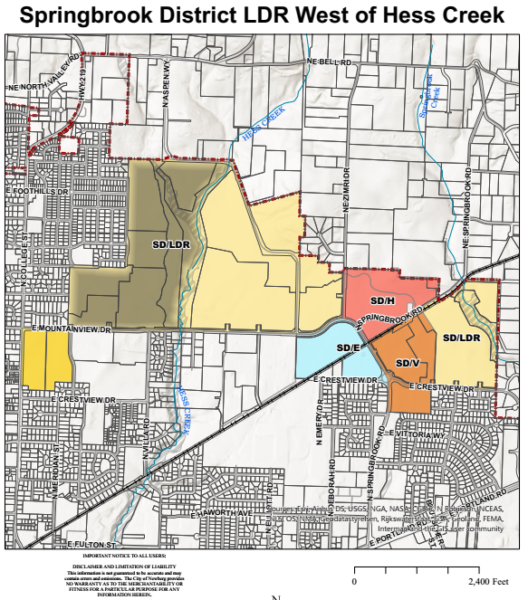
Master Plan Matrix Amendment Map
Notes:
Only the minimum lot width “frontage” would be changing in all of SD/LDR. Shaded area on right is SD/LDR west of Hess Creek where all new proposed regulations would occur.

Slide 12
Master Plan Amendments
Proposed Changes to the Springbrook Master Plan Development Standards Matrix in the Low Density Residential District:
Allow middle housing lots to have a minimum 20’ lot frontage
Change additional design standards currently applied to detached quadplex developments to all middle housing developments west of Hess Creek
Reduce driveway separation for quadplex and duplex lots to 20’
Allow shared driveways to have a 24’ wide access/utility easement with a 16’ wide paved surface
Fix clerical/inconsistency errors

Slide 13
Master Plan Amendments
For all of Springbrook District Low Density Residential Zone
Development Standard Regulation | Current Requirement | Location of Requirement | Proposed Requirement in Development Matrix
Lot frontage for middle housing lots (other than Townhouses) | 32 feet except only 20 feet for attached dwellings | Springbrook Master Plan Development Standards Matrix | 32 feet except only 20 feet for middle housing dwelling units
For Springbrook District Low Density Residential Zone west of Hess Creek
Driveway Separation for Middle Housing Lots | 22 feet | NMC 15.505.030(R)(4)(a) and Condition of Approval C(4)(bb)(2) and (3) for Order No.2023-44 and Ordinance 2023-2915 | 20 feet for quadplex and duplex lots
Shared Driveways | 25-foot-wide access/utilities easement with a 20 ft. wide paved surface | NMC 15.405.030(D)(1)(a) and Condition of Approval C(4)(bb)(6) for Order No. 2023-44 and Ordinance No. 2023-2915 | 24-foot-wide easement with a 16-foot-wide paved surface.
Order No. 2023-44 and Ordinance No. 2023-2915 have conditions of approval related to the proposed Master Plan Matrix. The conditions are discussed in the Findings section of the staff report.

Slide 14
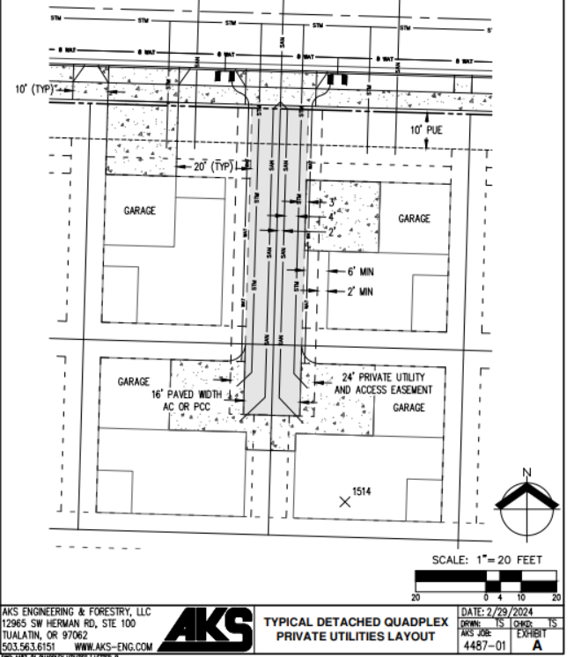
Applicant’s Proposed Quadplex Lot Configuration

Slide 15
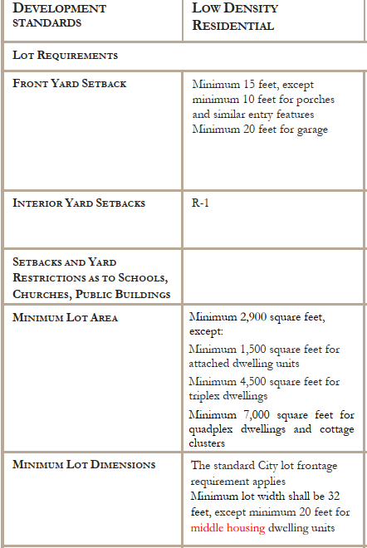
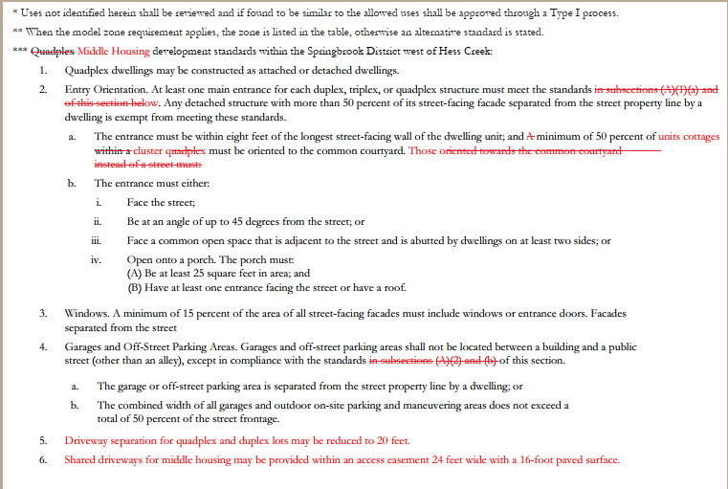
Master Plan Matrix Amendments

Slide 16
Master Plan Findings & Conditions
Exhibit “B”: Findings – File MISC323-0001
The proposed lot frontage of 20’ for middle housing is acceptable as it gives greater flexibility for middle housing
Shared driveway access/utilities easement of 24’ with 16’ wide paved surface can be done (8’ each side for cars to pass each other)
The proposed driveway separation of 20’ for quadplex and duplex lots does not preserve on-street parking. Staff recommends denying this portion of the Matrix request
Three (3) conditions of approval recommended in Exhibit “D”

Slide 17
Recommendation
Continue hearing until May 1, 2024, to allow for the completion of 35-day notice to the Department of Land Conservation and Development (DLCD)
At the continued hearing on May 1, 2024, adopt Planning Commission Resolution No. 2024-393, which approves the requested phasing modifications and approves portions of the requested Master Plan Matrix with the attached conditions of approval.
Notes:
Explain DLCD and that applicant has requested meeting for May 1, 2024.

