Slide 1
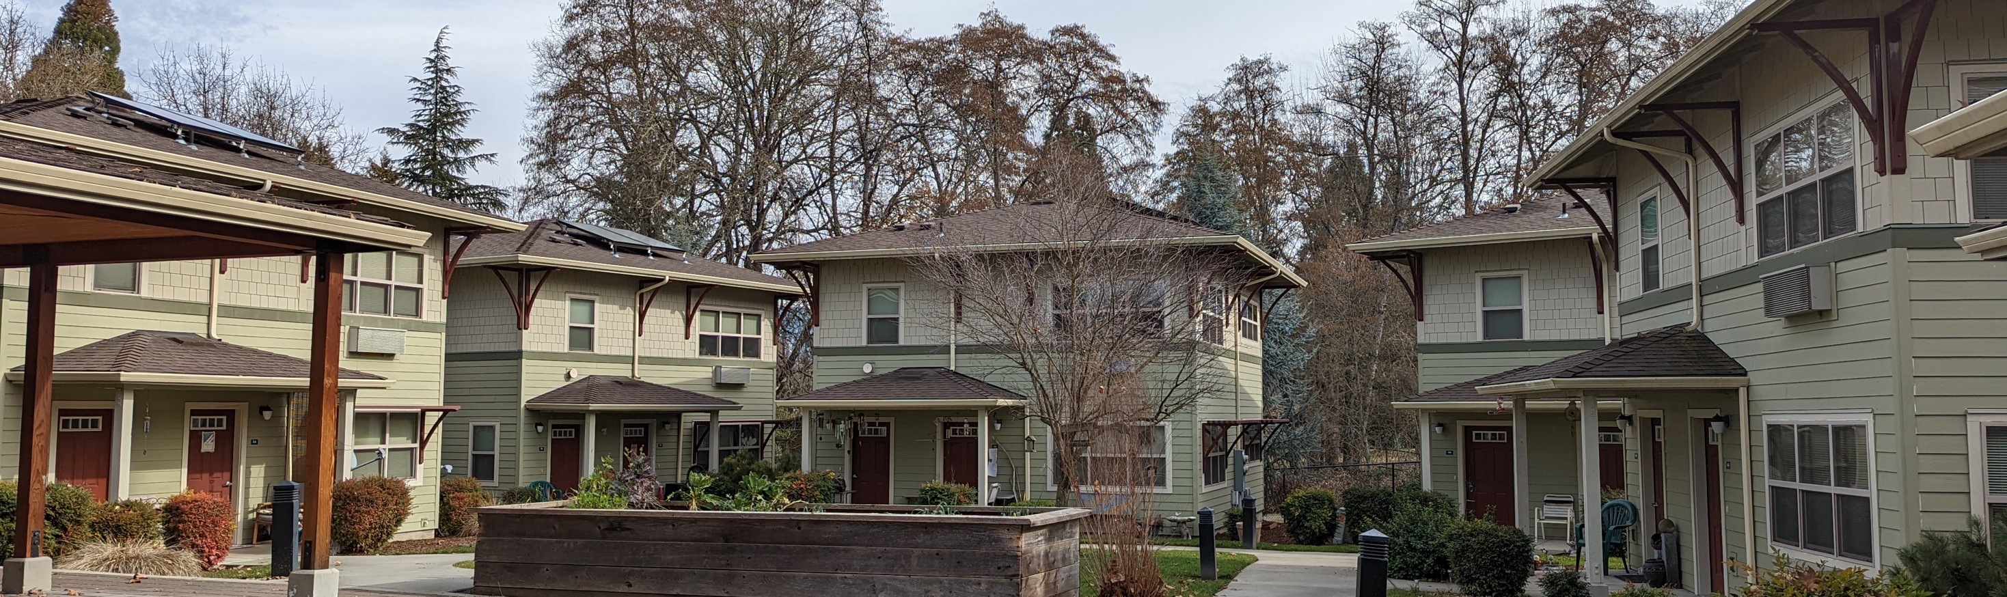
Newberg: Housing Production Strategy
Citizen Advisory Committee Meeting #1
April 12, 2022

Slide 2
Project Overview

Slide 3
A Housing Production Strategy is an 8 Year Action Plan
Contextualizing Housing Need: What is Newberg’s future housing need
Develop strategies to meet future housing need
Evaluation of all strategies to achieve fair and equitable housing outcomes
Stakeholder engagement, especially of protected classes
Housing Production Strategy Report with policies or actions that Newberg will implement

Slide 4
Why is Newberg Conducting an HPS?
Build on Newberg efforts to meet the city’s housing needs
  Housing Needs Analysis
  Newberg Housing Strategy
  Middle Housing – Community Outreach
  Housing Newberg Group
  Affordable Housing Task Force
The City was given a grant by DLCD to complete the HPS
Cost Burden by Tenure, Newberg, 2015-2019
Source: U.S. Census, American Community Survey 2015-2019

Slide 5
Cost Burden by Tenure and Income, 2015-2019
Cost Burden by Income for Renter Households, Newberg, 2015-2019
Cost Burden by Income for Owner Households, Newberg, 2015-2019
93%
94%
92%
63%
55%
55%
40%
43%
12%
4%
Source: U.S. Census, American Community Survey 2015-2019

Slide 6
How is the HPS Connected to the HNA?
Housing Needs Analysis
Buildable lands inventory
Housing Production Strategy
Refined understanding of housing need
Housing market
Demographics & socioeconomic characteristics
Housing affordability
Forecast of new housing
Assessment of land sufficiency
Identification of potential strategies
Evaluation of gaps in existing policies
Evaluation of new strategies
Assessment of whether the strategies help achieve fair and equitable outcomes
Housing Strategy

Slide 7
Project Schedule and Primary Tasks
We are here

Slide 8
Key Housing Needs in Newberg

Slide 9
What is Housing Need?
Housing that is affordable based on income
  Access to housing where housing costs are less than 30% of a households’ gross income
    HUD standard that does not account for wealth, debts, special costs
Access to housing that meets the unique needs of a household
  Size and household composition
  Location relative to work and school, ”high opportunity” areas
  Characteristics of unit and neighborhood
  Access without discrimination (Fair Housing)

Slide 10
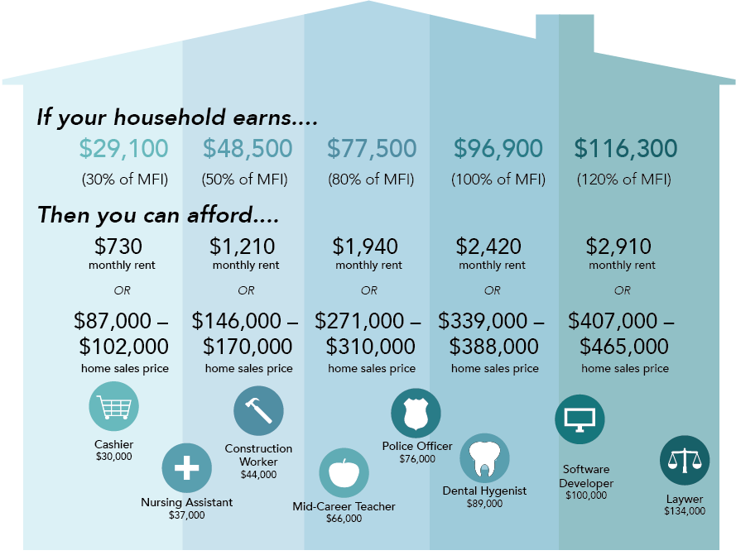
Financially Attainable Housing
Median Home Sale Price in Newberg:
$443,000.
A household would need to earn about $126,600 (131% of MFI) to afford these prices.
Average Asking Rent in Newberg (2021):
$1,200 (not including utilities)
A household would need to earn about $48,500 or 50% of MFI to afford this rent.
Source: U.S. Census Bureau, ACS 2015-2019, Table B19001; HUD, FY 2021 MFI.

Slide 11
Share of Households by Income Level, Newberg
This chart is based on the HUD MFI for Yamhill County and the ACS household income distribution for Newberg.
Publicly Subsidized Affordable
0%-60% MFI
Middle Income
60%-120% MFI
Market Rate
120%+ MFI
Source: U.S. Census Bureau, ACS 2015-2019, Table B19001; HUD, FY 2021 MFI.
Notes:
H

Slide 12
Housing Affordability by Income Levels
The housing market cannot produce income-restricted, subsidized affordable housing and often does not produce middle income affordable housing without subsidy.
Income-Restricted Subsidized Affordable Housing
0% - 60% MFI
Middle Income Affordable Housing
60% - 120% MFI
Market Rate
120% + MFI
Extremely Low Income
<30% MFI
<$29,100
Very Low Income
30%-50% MFI
$29,100-
$48,500
Low Income
50%-80% MFI
$48,500-
$77,500
Middle Income
80%-120% MFI
$77,500-
$116,300
High Income
>120% MFI
>$116,300

Slide 13
Newberg’ Current & Future Households by Income
2,418
2,474
2,160
2,211
2,049
Publicly Subsidized Affordable
Middle Income
Market Rate
Source: 2015-2019 ACS, U.S. Census; PRC at PSU (2020-2040); and U.S. Department of HUD 2021 MFI.
Median Family Income (MFI) is estimated for a family of 4.

Slide 14
Summary of Housing Affordability Based on Income
A household would need to earn $48,500 to afford multifamily rent of $1,200 (50% of MFI for a family of four)
A household would need to earn around $126,600 to afford the cost of a house around $443,000 (131% of MFI for a family of four)

Slide 15
Housing Needs Often Differ by Group
Point-in-Time Homelessness Estimates, Yamhill County, 2015-2021
People experiencing homelessness:
  Temporarily or chronically
  Alone or with children
Racial or ethnic groups
People over 65 years old
People with disabilities
Source: Oregon Housing and Community Services.
Note: OHCS reported two counts in 2021 – estimated and reported counts. This is the estimated counts.

Slide 16
Conclusion: Housing Need for People Experiencing Homelessness
Little data exists about the income of people experiencing homelessness
Statewide income* for people experiencing homelessness is:
  89% have income below 30% of MFI
  8% have income of 30% to 50% of MFI
  3% have income of 50% to 80% of MFI
People experiencing homeless are unable to afford market-rate housing
  757 persons were identified as homeless in Yamhill County in the 2021 estimated PIT Count
Unique housing need that varies by reason for homelessness
  Emergency assistance, including rent support
  Permanent supportive housing, with services
  Access to an affordable unit
* Source: OHCS data from EHA/SHAP
From the Report Implementing a Regional Housing Needs Analysis Methodology in Oregon: Approach, Results, and Initial Recommendations by ECONorthwest, August 2020

Slide 17
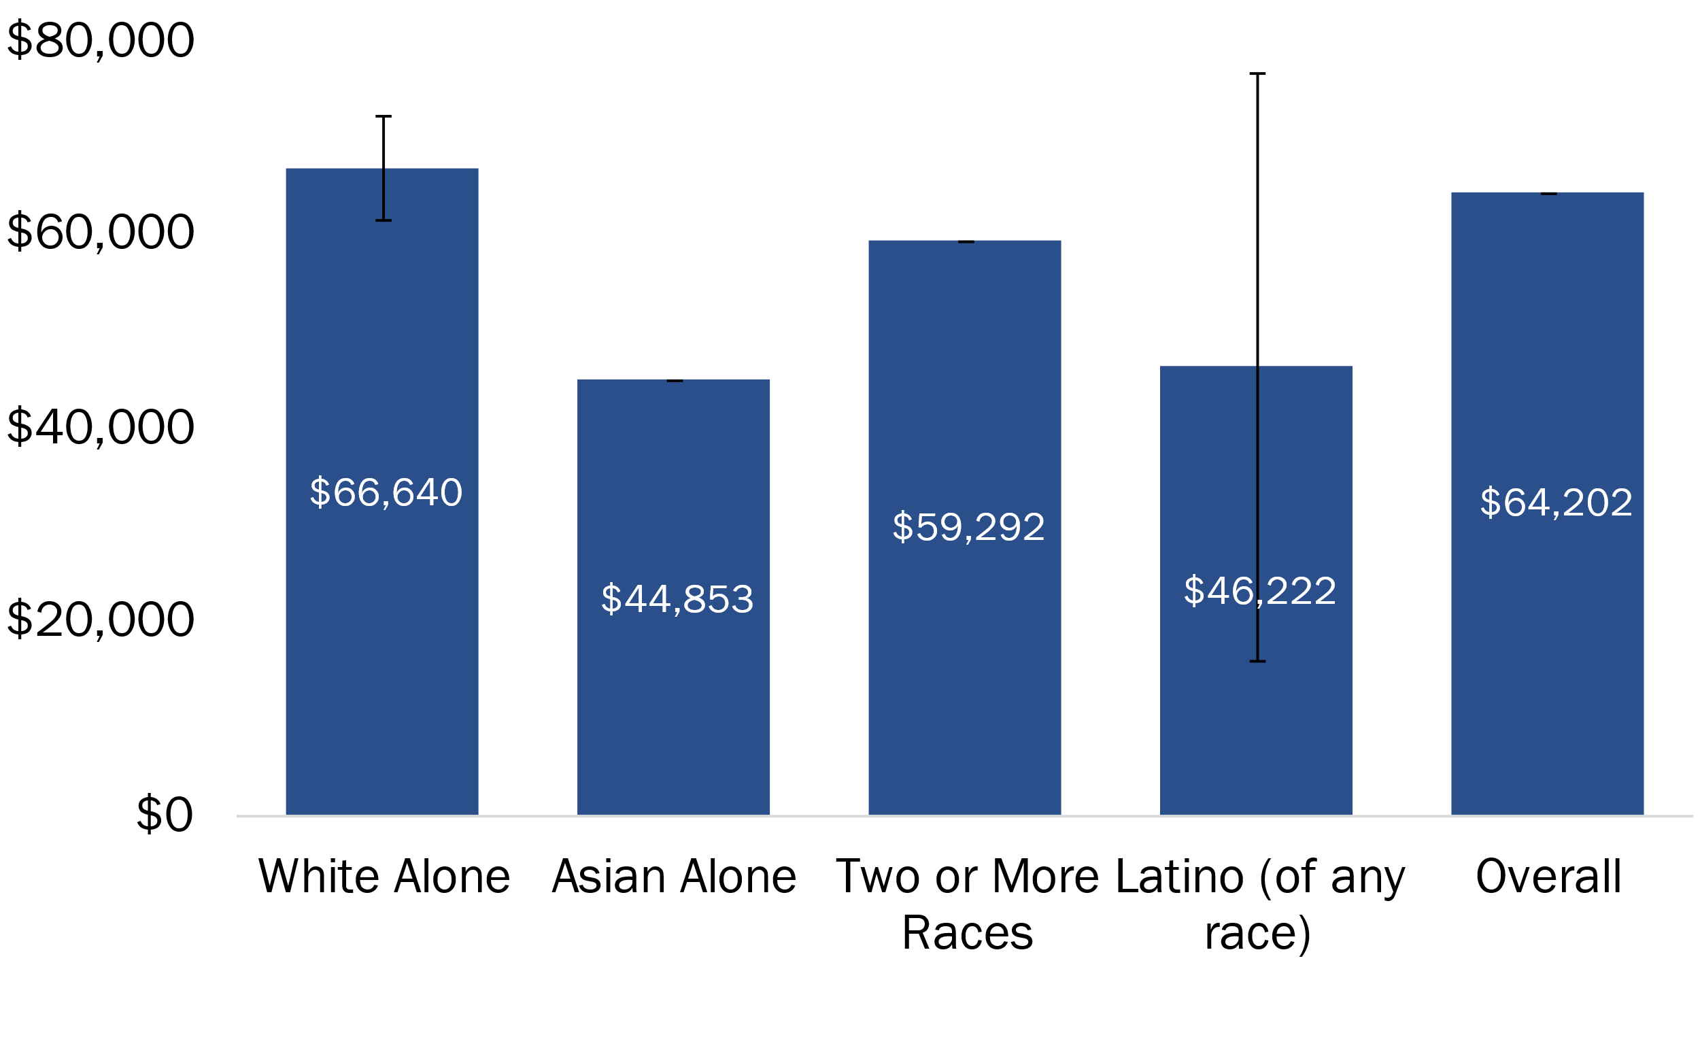
Ability to Pay for Housing by Race and Ethnicity
Median Household Income by Selected Race and Ethnicity, 2015-2019
The largest racial and ethnic groups in Newberg are:
White alone: 18,144 people, 78% of population
Latino: 3,355 people, 14% of population
Source: U.S. Census, American Community Survey 2015-2019
Note: Other races not included due to lack of data and / or high margins of error
Notes:
$44.5K – All
Black - $22.5K
Latino - $36.5K – 82% of overall average

Slide 18
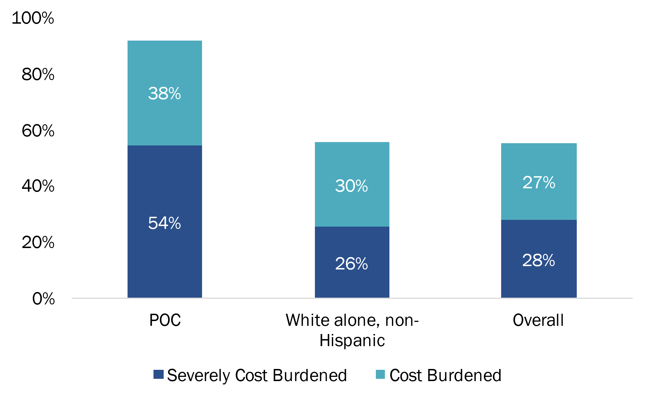
Cost Burden by Race and Ethnicity
Cost Burdened Households by Race and Ethnicity, 2014-2018
92%
56%
55%
Source: CHAS 2014-2018, Table 9
Note: POC includes Latino

Slide 19
Conclusion: Housing Need by Race and Ethnicity
Racial and ethnic groups have disproportionate cost burden
  In Newberg, households that identified as people of color (POC) were disproportionately cost burdened compared to the city’s average.
  Latino (any race) is the largest ethnic or racial Community of Color in Newberg (14% of the population) and has a median income lower than the city’s average.
  Unique housing need
  Access to affordable unit
  Access to housing in locations with “high opportunity,” such as access to jobs, transit, services, or high-quality education
  Access to housing without discrimination
Uncertain housing preferences
  Do some racial or ethnic groups rent at higher rates because of preference or because of lack of affordable homeownership opportunities?

Slide 20
People Aged 65 Years and Older: Ability to Pay for Housing
Median Household Income by Age
In Newberg, median household income for people over 65 years is 77% of the overall average.
Source: 2015-2019 American Community Survey, U.S. Census

Slide 21
Conclusion: Housing Need for People 65 Years and Older
People 65 years of age and older are disproportionately cost burdened
  67% in the Willamette Valley Region* are cost burdened
  4,204 people are over 65 years of age in Newberg and forecast to grow.
Unique housing need that varies for seniors
  Physically accessible housing
  Access to affordable unit
  Access to housing with needed services
  Access to housing without discrimination
*From the Report Implementing a Regional Housing Needs Analysis Methodology in Oregon: Approach, Results, and Initial Recommendations by ECONorthwest, August 2020

Slide 22
Persons with a Disability
Share of Persons with a Disability by Type (% of Total Population), Newberg, 2015-2019
Source: 2015-2019 American Community Survey, U.S. Census

Slide 23
Conclusion: Housing Need for People with a Disability
People with a disability have disproportionate cost burden
  61% in the Willamette Valley Region* are cost burdened
  In Newberg, 2,187 residents have one or more disabilities and likely to grow with an aging population
Unique housing need that varies by disability
  Physically accessible housing
  Access to affordable unit
  Access to housing with needed services
  Access to housing without discrimination
*From the Report Implementing a Regional Housing Needs Analysis Methodology in Oregon: Approach, Results, and Initial Recommendations by ECONorthwest, August 2020

Slide 24
Next Step: Developing the Housing Production Strategy (HPS)

Slide 25
What is a city’s role housing development?
Policy—including zoning, density, and design requirements– must allow developer to build a profitable project.
Public Policy
Capital
Land
Market Feasibility
Cities can directly influence public policy, land, and infrastructure.
Cities may have limited influence on market feasibility
There must be sufficient demand (rents, sales prices) to support a profitable project
Development
Can Occur
Developer must
control the site with
reasonable acquisition costs
Developer must be able to access resources for investment (e.g., equity investment, bank loans)

Slide 26
Housing Market Dynamics
Affordability
Median Family Income
Housing Stock Affordable to High-Income Households
New Market Supply
140%+
Filtering
(Depreciation)
120%
Renovation
Housing Stock Affordable to Moderate-Income Households
100%
80%
Gentrification
Neighborhood Change
New Subsidized Supply
60%
Housing Stock Affordable to Low-Income Households
Demolition
Notes:
Development that occurs at all price points
How new development changes over time
New development – generally targeted at over 120% of MFI for ownership, 80%-100% MFI for rental
Expensive to make housing happen – need price point that makes it happen
Will depreciate to middle and naturally occurring affordable housing
Will never depreciate to low income housing
This doesn’t happen when a housing market is undersupplied, like Portland
Depreciation doesn’t happen, gentrification may happen
Subsidized housing development is more important in undersupplied market then
Focus policy interventions at low-income housing – subsidized supply

Slide 27
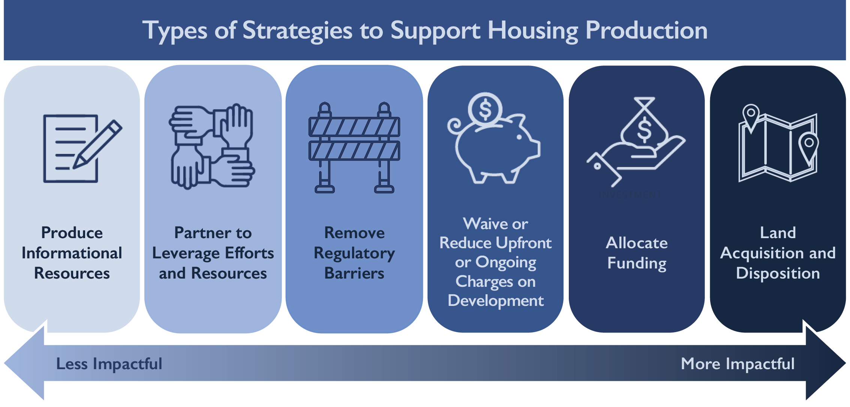
Develop Strategies to Meet Future Housing Need

Slide 28
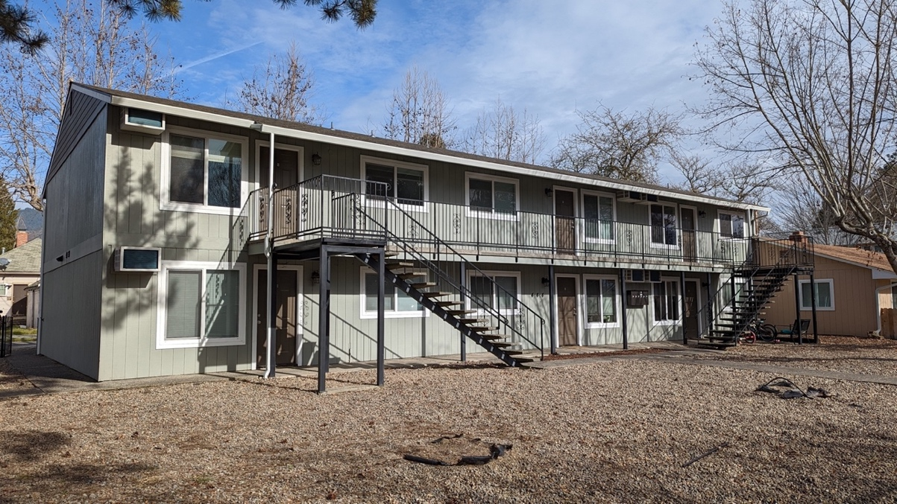
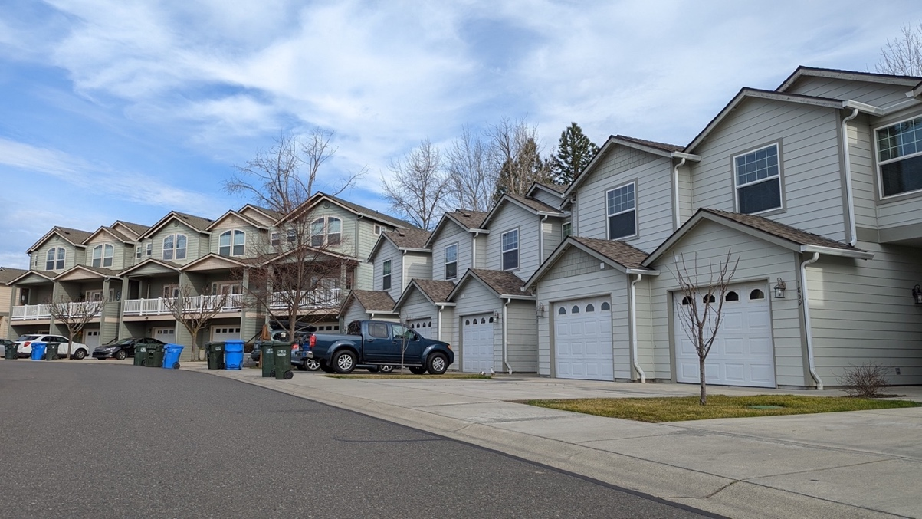
Requirements of Strategies in the HPS
For strategies identified in the final HPS, the City of Newberg will:
  Commit to implementation
  Be required to update DLCD on implementation progress, and be required to comment on its effectiveness in the future
Strategies not identified in the HPS may still be implemented by the City, but the City will not be held to specific action by the State.

Slide 29
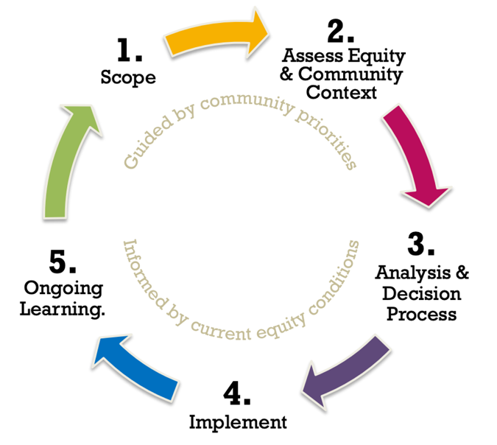



Evaluating the strategies together
Do the strategies achieve fair and equitable housing outcomes?
Affordable homeownership and affordable rental housing
Gentrification, displacement, and housing stability
Housing options for residents experiencing homelessness
Location of housing, within compact, mixed-use areas
Housing Choice, in safe neighborhoods with high-quality amenities
Fair Housing, especially for federal and state protected classes
Source: King County
Distributional Equity
Process Equity
Cross-generational Equity

Slide 30
Existing Strategies in Newberg
Amendments to Accessory Dwelling Units – 2018
Residential use in first floor in C-3 –2019
Removed ADU Parking requirements –2020
Housing Needs Analysis – 2021
Middle Housing Code Updates – Duplexes – 2021
Middle Housing Code Updates – Triplexes, Quadplexes, Townhomes, & Cottage Clusters– 2022
Fee-in-lieu Parking for Residential Development in Downtown – 2020
Establish a Vertical Housing Development Zone (VHDZ) for Tax Abatement – 2021
CDBG Manufactured Home Repair Grant – 2016 and 2020
Establish a CET – 2020
Adjust timing on payment of SDC – 2020
Annual Affordable Housing Trust Fund Notice of Funding Availability – ongoing

Slide 31
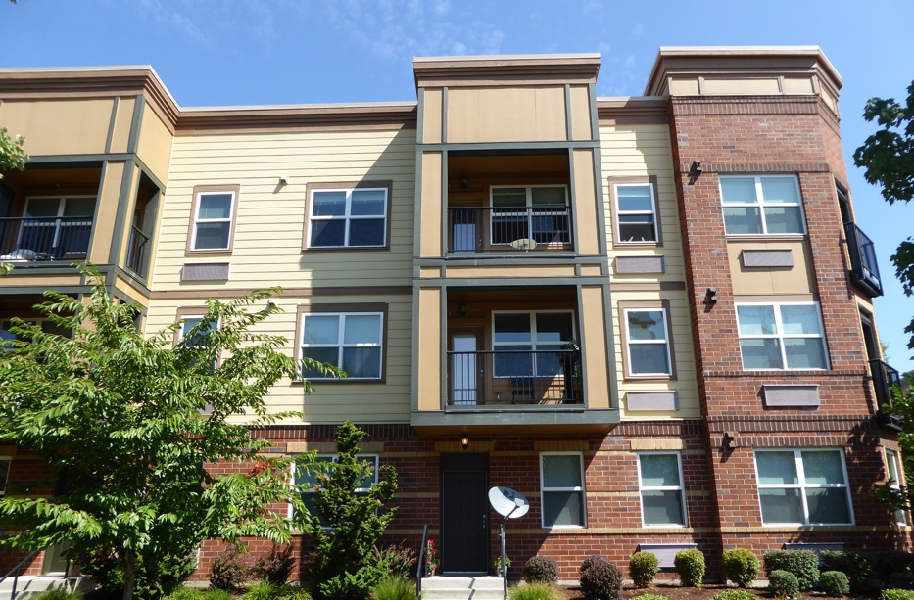
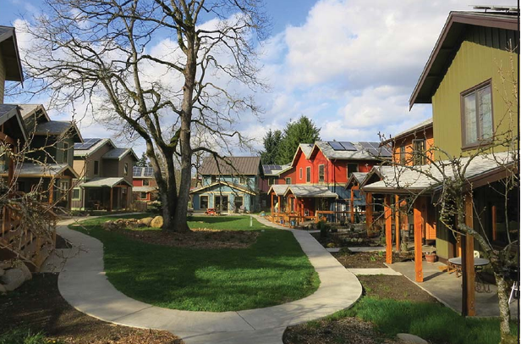
Potential Categories of Strategies for the HPS
Provide support and safe housing options for people experiencing homelessness
Expand affordable housing options for low-income renters (with income less than 60% MFI)
Preserve and maintain existing housing and newly developed affordable to low- and moderate-income households (with income between 60% and 80% MFI)
Support opportunities to achieve and maintain homeownership by moderate-income households (with income between 80% to 120% of MFI)

Slide 32
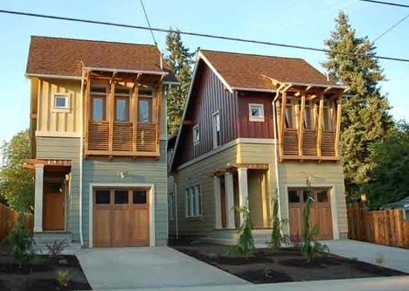
Categories of Strategies (continued)
Expand accessible housing options for people with disabilities and seniors
Address regulatory issues to support development, preservation, and redevelopment of housing, including in commercial and mixed-use neighborhoods.
Plan for and develop transportation and public infrastructure to support housing development
Identify funding sources to implement the HPS

Slide 33
Draft Housing Advisory Committee Work Plan Strategies
The Newberg Housing Strategy provides a starting point for the HPS
Summary of potential strategies for the HPS
  Revise zoning code to increase allow smaller lot sizes
  Evaluate tax exemptions for affordable housing
  Consider using Urban Renewal
  Consider establishing a Construction Excise Tax
  Consider reducing or waiving fees for affordable housing
  Evaluate options to fund affordable housing

Slide 34
What are the barriers to developing affordable housing?
Infrastructure necessary to support housing development
Funding and resources (such as land) to support development of affordable housing
Support from the community for development of affordable housing, including regulated affordable housing
Capacity of the development community for development of diverse housing types
Regulatory barriers to developing multifamily housing
Establishing or broadening needed partnerships
Are there other barriers to developing affordable housing in Newberg?

Slide 35
Next Steps
Kickoff
Jan
2022
Contextualized Housing Need
Feb – May
2022
Strategies
Mar – Nov
2022
Draft HPS
Aug – Jan
2022- 2023
Final HPS & Adoption
Feb – May
2023
Project Kickoff
Analyze housing need & anti displacement considerations
Gather input from housing consumers
Identify policy gaps & potential strategies
Evaluate strategies
Engage housing producers & service providers
Compile and have public review of the report
Adopt the strategy
TECHNICAL ANALYSIS
CC meeting #6
Open house
PC presentation
Council presentation
CC meeting #1
CC meetings (#2-5)
PC presentation
Council presentation
PC presentation
Council presentation
OUTREACH
We are here
Summary of major tasks
Project schedule
Engagement preparation
Housing need & anti-displacement memo
Memos summarizing existing / potential measures
Summary of developer interviews
Draft HPS report
Final HPS report
DELIVERABLES

