Slide 1
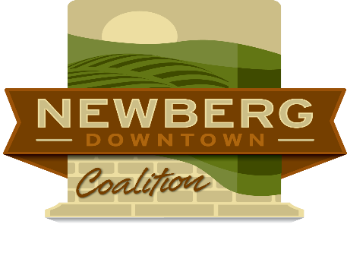
Newberg Economic Development Strategy Annual Report August 2018

Slide 2
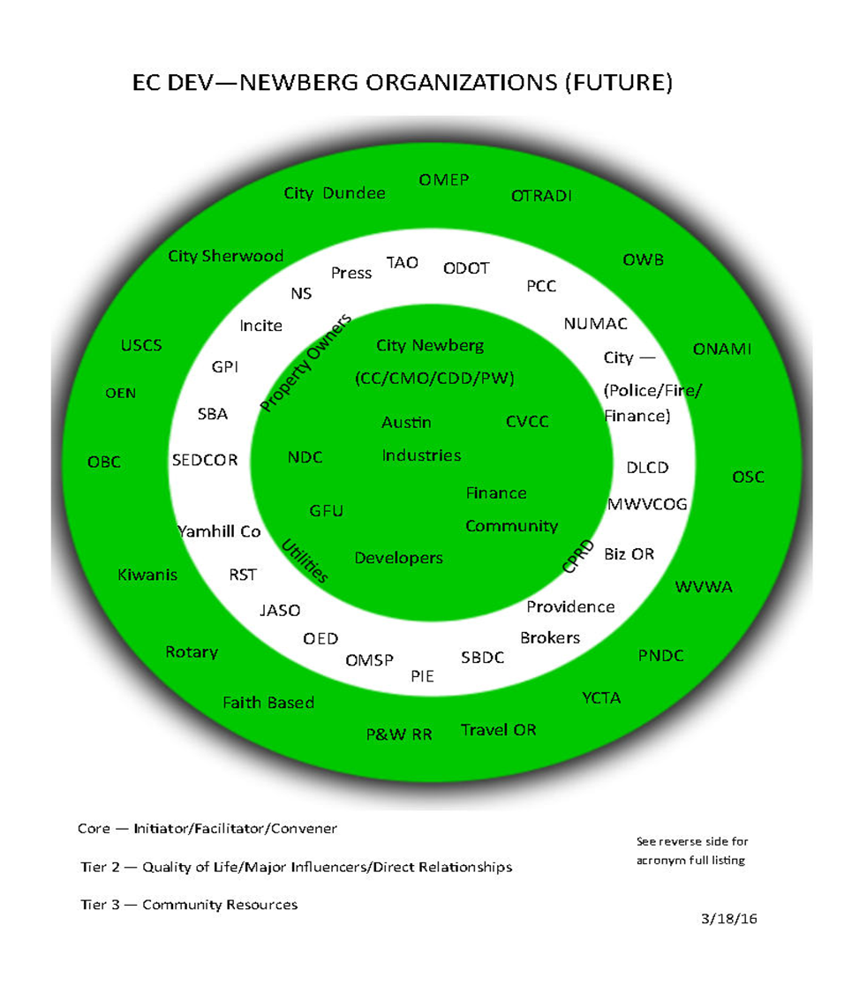

Slide 3
Four Pillars of Activity
Industrial Sector
Commercial Sector
Business Development & Workforce
Tourism & Hospitality

Slide 4
Strategies & Actions
Strategy Type | # of Strategies | # of Actions
Industrial Sector | 9 | 68
Commercial Sector | 7 | 41
Business Development & Workforce | 8 | 80
Tourism & Hospitality | 3 | 24

Slide 5
Industrial Sector Accomplishments - Strategies
Focus second year on 4 Strategies & 21 actions:
Diversify local economy
Retain & Expand Existing Industrial Businesses
Recruit Traded Sector Companies
Increase Industrial Land Supply

Slide 6
Industrial Sector Accomplishments – Diversify Local Economy Actions
Implement one or more of the vertical wine integration demonstration projects (1.1.6)
Supply chain analysis of the four (4) existing traded sector industries and targeted industries (1.1.6)
Conduct retention visits (1.2.1)
Leverage the Business Resource Center implementation (1.2.2)
Coordinate recruitment activities (1.3.1)

Slide 7
Industrial Sector Accomplishments – Retention/Expansion/Recruitment Actions
City coordinates recruitment activities with Biz OR, SEDCOR and GPI (1.3.1)
Recruitment of food processing (wine) companies and suppliers (1.3.7)
Build and maintain relationships with Biz OR, SEDCOR and GPI (1.4.1)
Conduct annual roundtable forum on economic development activities with regional, state and federal organizations 1.4.5)
Connect the organizations to the Business Resource Center as it develops (1.4.6)

Slide 8
Industrial Sector Accomplishments – Supply of Industrial Land Actions
Coordinate data gathering and marketing material with SEDCOR, GPI and MWVCOG (1.5.5)
Develop community profile to place on Greater Portland Inc. web site (1.5.9)
Promote the Business Resource Center and it’s resources (1.5.10)
Identify needed infrastructure and financing for the infrastructure (1.6.6)

Slide 9
Industrial Sector Accomplishments – Supply of Industrial Land Actions
Expand the Urban Growth Boundary (1.6.7)
Identify shovel ready sites (1.6.8)
Tell the story of the expansion to build community support for future expansions (1.6.9)
Follow-up interviews with expansion and new industrial developments (1.7.4)
Enhance city permitting processes. (1.7.5)

Slide 10
Industrial Sector Accomplishments – Supply of Industrial Land Actions
Update sanitary sewer master plan (1.8.4)
On-going coordination with utility companies (1.8.5)
Work with stakeholders to obtain funding for the east leg of the Newberg-Dundee Bypass (1.9.4)

Slide 11
Commercial Sector Accomplishments – Strategies
Focus second year on 3 Strategies & 18 actions:
Revitalize Downtown Newberg
Retain existing commercial & retail businesses
Increase supply of commercial & retail land

Slide 12
Commercial Sector Accomplishments – Downtown Revitalization Actions
Secure funds for downtown improvement implementation (2.1.5)
Implement recommendations from the Newberg Downtown Improvement Plan (2.1.6)
Evaluate options for an Urban Renewal Area (URA), Business Improvement District (BID), or Economic improvement District (EID) (2.1.7)
Research best practices from comparable sized cities on downtown development activities (2.1.8)

Slide 13
Commercial Sector Accomplishments – Retain Existing Commercial & Retail Actions
Enhance permitting (2.2.2)
Interview businesses exiting Newberg (2.2.3)
Leverage the development of the Business Resource Center (2.2.4)
Work with partners to market sites (2.3.2)
Meet with property owners on development and redevelopment opportunities (2.3.3)

Slide 14
Commercial Sector Accomplishments – Retain Existing Commercial & Retail Actions
Develop a program for possible property assemblage (2.3.4)
Enhance existing or create new incentive packages (2.3.5)
Evaluate the feasibility of an urban renewal program downtown (2.3.6)
Update inventory of vacant and underutilized sites (2.3.7)

Slide 15
Commercial Sector Accomplishments – Retain Existing Commercial & Retail Actions
Establish processes and programs for connecting the brokerage community (2.4.4)
Continue marketing program (2.4.5)
Implement recommendations for the Newberg Downtown Improvement Plan (2.5.2)
Establish business startup assistance program as a part of the Business Resource Center (2.6.4)
Expand the Urban Growth Boundary (2.7.5).

Slide 16
Business Development & Workforce Accomplishments – Strategies
Focus second year on 3 Strategies & 21 actions:
Establish an Innovation Accelerator
Expand Workforce Development efforts
Establish a Business Resource Center

Slide 17
BD & Workforce Accomplishments – Innovation Accelerator Actions
Establish the Chehalem Valley Entrepreneurs Network (3.1.5)
Promote and market the Accelerator (3.2.8)
Evaluate if eScripts is a viable tool (3.3.6)
Promote the Buy Local program and its success (3.3.7)
Establish marketing and recruitment program (3.4.3)
Establish a dedicated space for food carts (3.4.4)

Slide 18
BD & Workforce Accomplishments – Workforce Development Actions
Promote development of vacant parcels (3.4.5)
Continue marketing and recruitment program (3.4.6)
Establish a position in the Business Resource Center (3.4.7)
Implement mentorship program at NHS (3.5.8)
Extend the Chamber of Commerce internship to run year-round (3.5.9)
Facilitate region-wide collaboration between workforce development stakeholders (3.5.10)

Slide 19
BD & Workforce Accomplishments – Business Resource Center Actions
Extend opportunities for local students to earn technical degrees (3.5.11)
Implement employability soft skills curriculum in NSD (3.5.12)
Build and leverage best practices (3.5.13)
Facilitate region-wide collaboration between workforce development stakeholders (3.6.10)
Apply for funding/grants to expand operations (3.6.11)
Integrate goals and purpose with the CVIA, GFU, PCC, Chemeketa (3.6.12)

Slide 20
BD & Workforce Accomplishments – Business Resource Center Actions
Fund a FTE dedicated to expansion of workforce development programs (3.7.7)
Establish a regional angel funding program to support the CVIA (3.8.4)
Evaluate non-traditional financing programs (3.8.5)

Slide 21
Tourism & Hospitality Accomplishments – Strategies
Focus second year on 2 Strategies & 9 actions:
Increase tourism & visitor counts
Establish Transient Lodging Tax program

Slide 22
Tourism & Hospitality Accomplishments – Increase Tourists/Visitor Actions
Enhance signage & gateways elements in the downtown area for tourists and visitors (4.1.2)
Create a regional marketing campaign that promotes Newberg and the valley as a destination location (4.1.8)
Work with major businesses, George Fox University, Sportsman Airpark, the Allison Inn & Spa, local major wineries, and other national/international sources of potential visitors to increase out-of-region destination traffic (4.1.9)

Slide 23
Tourism & Hospitality Accomplishments Increase Tourists/Visitor Actions
Establish annual reporting on tourism activities (4.1.10)
Evaluate redesigning Francis Square as an event venue (4.2.5)
Evaluate expanding the number of events and activities (4.2.6)
Continue the build-out of the Newberg Cultural District as a premier event venue (4.2.7)
Establish a classic car/concourse de elegance (4.2.8)
TLT Ad Hoc Committee (4.3.3)

Slide 24
Other Accomplishments – Industrial/Commercial
Continuation of many activities from Year 1 in the Industrial Sector
Continuation of many activities from Year 1 in the Commercial Sector

Slide 25
Other Accomplishments – Business Development & Workforce
Move the Business Resource Center to a permanent facility (3.6.13)
Expand the facility, operations and services as needed (3.6.14)
Promote Chehalem Valley Chamber of Commerce programs (3.7.1)
Promote Portland and Chemeketa Community College programs (3.7.2)
Promote George Fox University programs (3.7.3)

Slide 26
Other Accomplishments – Tourism & Hospitality
Evaluate alternatives for a mid-tier hotel (4.1.6)
Coordinate events calendars (4.2.3)

Slide 27
Thank You for Your Support
NEDS Core Group:
Carr Biggerstaff
Mike Ragsdale
Mary Martin Miller
Jay Harris
Joe Hannan
Doug Rux

