Slide 1

Town Hall Meeting
Citizen Rate Review Committee
March 1, 2018

Slide 2
Agenda
Overview of Rate Setting Process
Capital Requirements
Recommended Revenues and Rates
Bill Comparisons
Next Steps

Slide 3
Overview of Rate-Setting Process

Slide 4
3-Step Rate-Setting Process
Financial Plan
Cost of Service Analysis
Rate Design

Slide 5
Financial Plan Development
Annual cash flow projections over 5-10 year periods
Sources
of Funds
Operating
Expenses
Capital
Financing
Other
Requirements
Reserves
Personnel
Cash Funded
Fund Transfers
Service Revenues
Materials
Debt Service
Future Capital
Reserves
SDCs*
Services
Miscellaneous Fees
Utilities
Other (interest,
grants, etc.)
Repair & Maint.
*SDCs = System Development Charges

Slide 6
Financial Plan Drivers
City Budget
Process
Economic
Factors
Master Planning: Regulatory Requirements; Repair & Replacement
Operation & Maintenance Costs
Capital Improvement Programs (CIP)
“Operational”
“Growth Related”
Service Charges (Rates)
SDCs
Existing Rate Revenue
Rate increases
Customer/
Consumption Trends
Financial
Policies
Growth Trends;
Legal Limitations

Slide 7
Current Rate Pressures
* Steady consumption and customer growth
* Future debt refinancing
* Existing reserves (wastewater)
* Replacement of aging infrastructure
* Large debt burden (water & wastewater)
* System reliability upgrades
Downward Pressure
Required Rate Increases
Upward Pressure

Slide 8
Capital Requirements

Slide 9
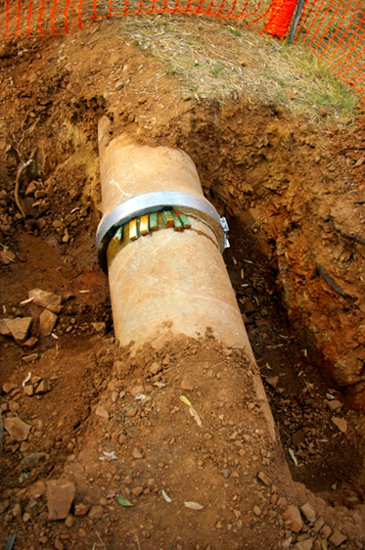
Capital Improvement Plan (Water)
Key Projects:
*Redundant Water Supply ($4 m)
*Chehalem Drive Extension ($1 m)
*Bell Pump stations ($2.5 m)
*Pipe upsizing and replacement ($2 m)

Slide 10
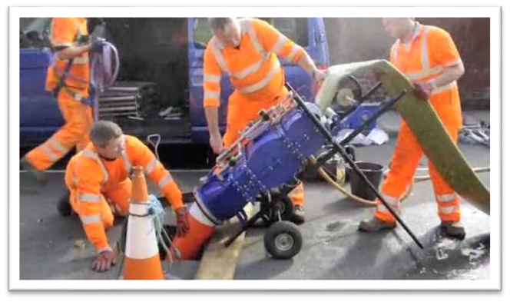
Capital Improvement Plan - Wastewater
Key Projects:
*Hess Creek ($3.5 m)
*Infiltration & Inflow ($5 m)
*Dayton Ave Pump station ($2 m)
*Oxidation ditch structural ($2 m)
*Chehalem Extension ($1 m)

Slide 11
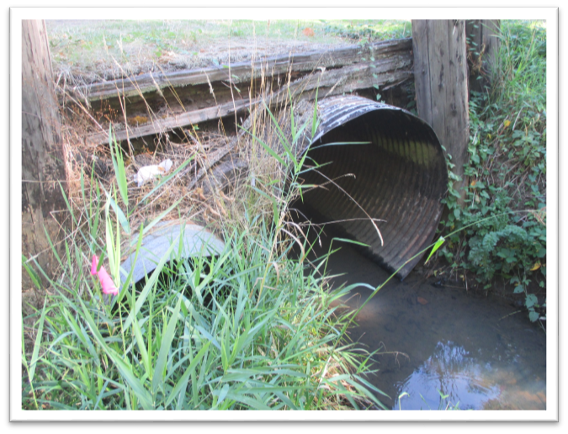
Capital Improvement Plan (Stormwater)
Key Projects (through 2023):
*Drainage upgrades ($2.0 m)
*Water Quality/regulatory ($0.3 m)
*Maintenance facility ($0.5 m)

Slide 12
Recommended Revenues & Rates

Slide 13
Financial Forecast - Water
Recommended annual rate revenue increase = 4.0%
*See handout for rate schedule

Slide 14
Financial Forecast - Sewer

Slide 15
Financial Forecast - Stormwater

Slide 16
Financial Forecast – Transportation
Recommended annual rate revenue increase = 0.0%
*See handout for rate schedule

Slide 17
Typical Residential Bill – All Systems

Slide 18
Residential Utility Bill Comparison (2018)

Slide 19
Factors Impacting Bill Comparison
Regional systems vs. single system
Infiltration & inflow investment
Debt burden
City policies (e.g. franchise fees)
Public vs private

Slide 20
Next Steps
CRRC Deliberation: March 15
City Council Public Hearing: April 2

